Slide 1
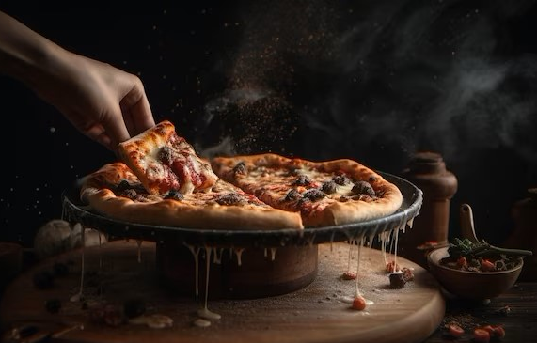
"Italian Pizza: Where Tradition Meets Taste!"
IS-601: Web System Development
Brijeshkumar Suvagiya- Designer
Vivek Dhameliya- Developer

Slide 2
Introduction
Competitive Analysis
SWOT Analysis
Archetype
AGENDA
User Stories
Sales Funnel Diagram
Design Feedbacks
Method of Persuasion
Development
Conclusion

Slide 3
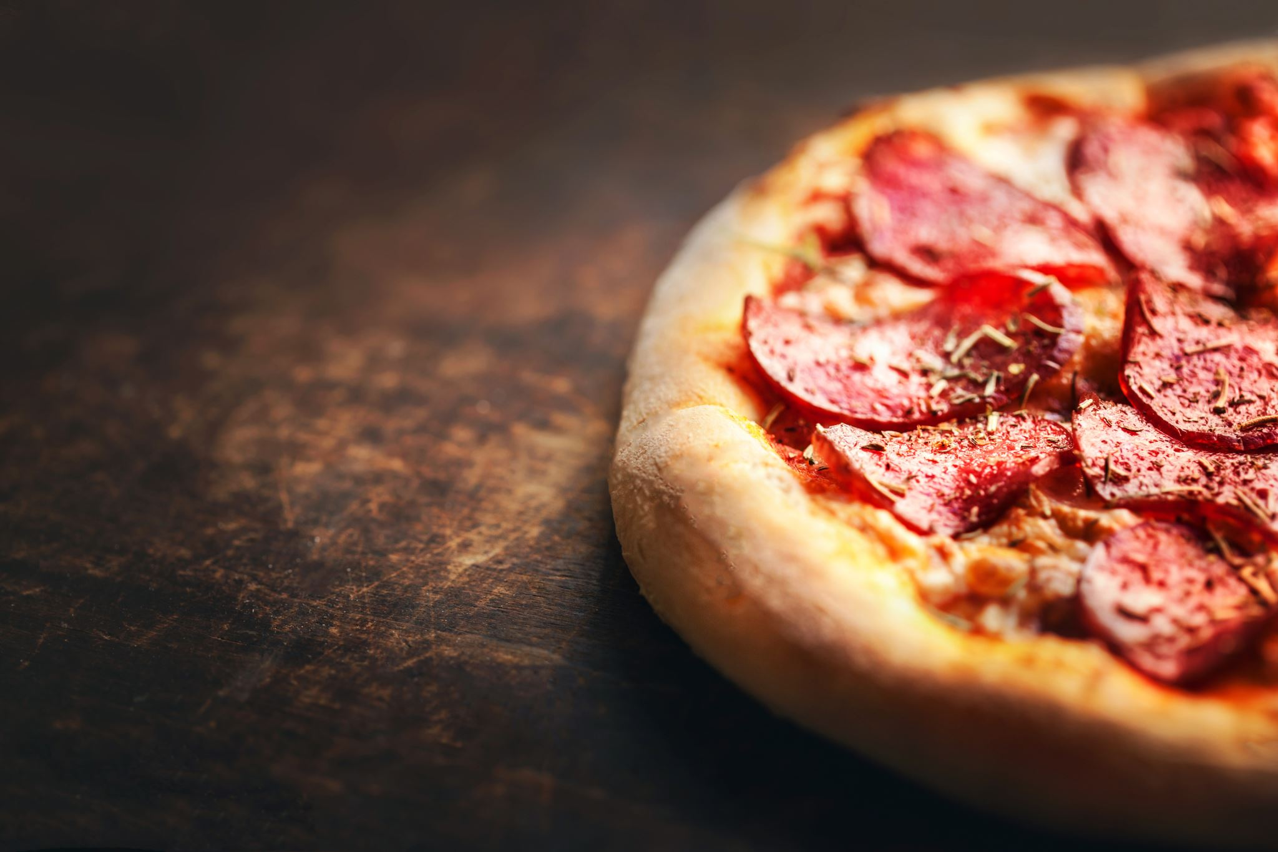
Introduction
Market Saturation and Competition
Developing an Italian pizza restaurant website allows us to understand how establishments like New York City Pizza and Vittoria Pizzeria, as highlighted in "The Best Pizza Restaurant Websites of 2023," leverage their online presence to stand out and succeed.
Within the context of this article, the prevalence of over 75,000 pizza businesses in the United States, with more than half being independently owned, underscores the intense competition in the pizza industry.

Slide 4
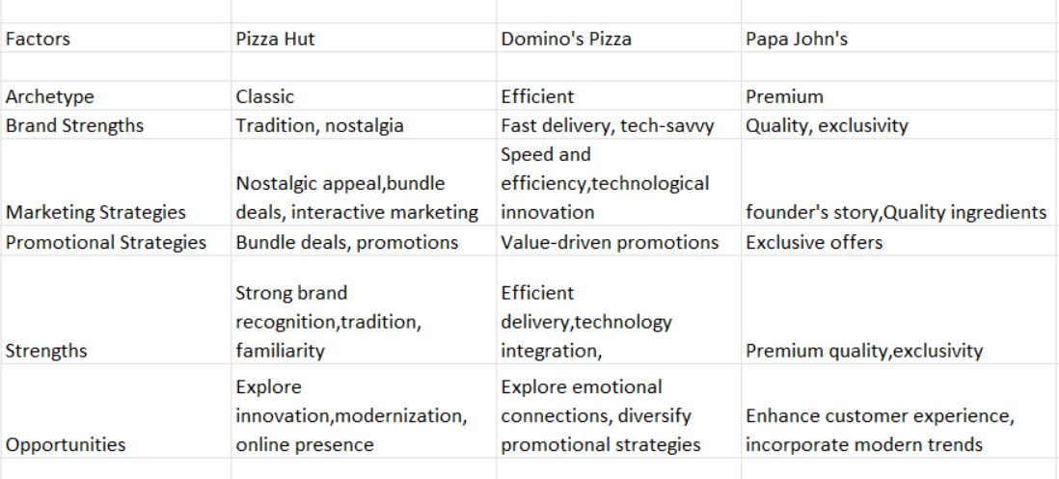
Competitive Analysis

Slide 5
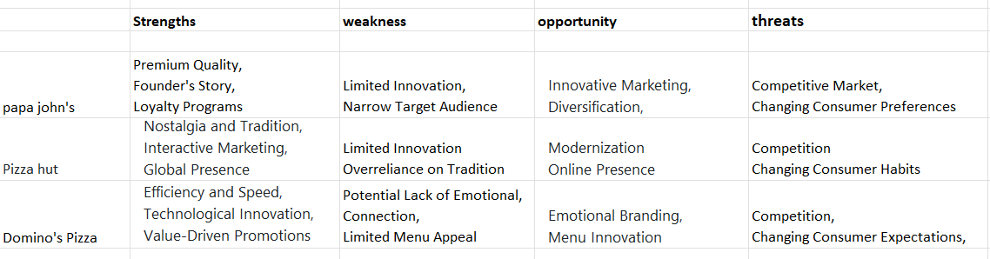
SWOT Analysis

Slide 6
Archetype
Jester Archetype:
Our Italian Pizza Restaurant Website embodies the Jester archetype, bringing a sense of joy and entertainment to our online presence. It is often associated with playfulness, humor, and a lighthearted approach. The inclusion of happy human faces, a chef symbol with a hand holding a pizza, and the use of fonts like medium italic and PoetsenOne suggests a fun and entertaining atmosphere. The orange color for clickable sections in the navbar adds an energetic and playful touch, further emphasizing the Jester archetype's characteristics.

Slide 7
User stories
EPIC: Mike found our pizza brand's website online, and as soon as he visited, he was welcomed by a captivating hero background that showcased our restaurant's logo, (interest).
ACTION: With easy navigation to pages like 'Home’, 'About Us’, ‘Menu’, and 'Contact Us' the hero text beckons him with 'Save up to 50% off.' Mike embarks on his pizza adventure by clicking the sign-up button(action), unveiling a summer treat – an exclusive 30% discount on the total cost, available for both online and in-store orders, email delivered directly to his email(Loyalty).

Slide 8
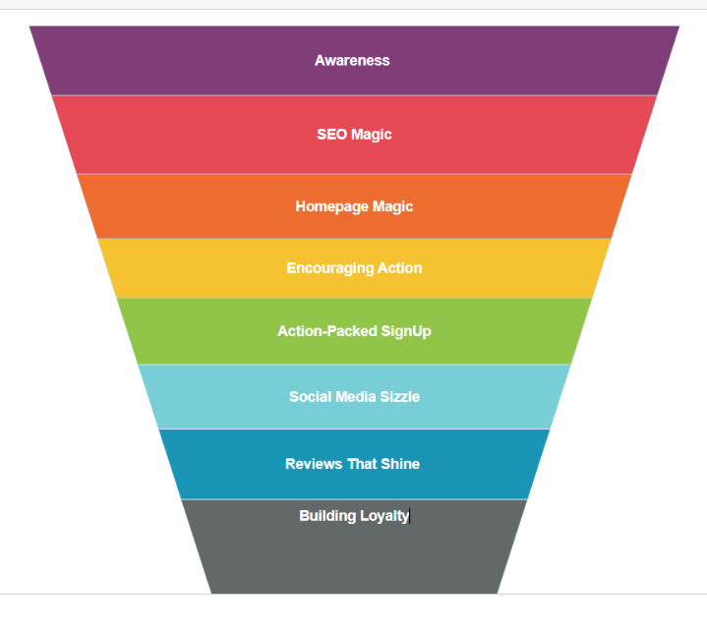
Sales Funnel Diagram

Slide 9
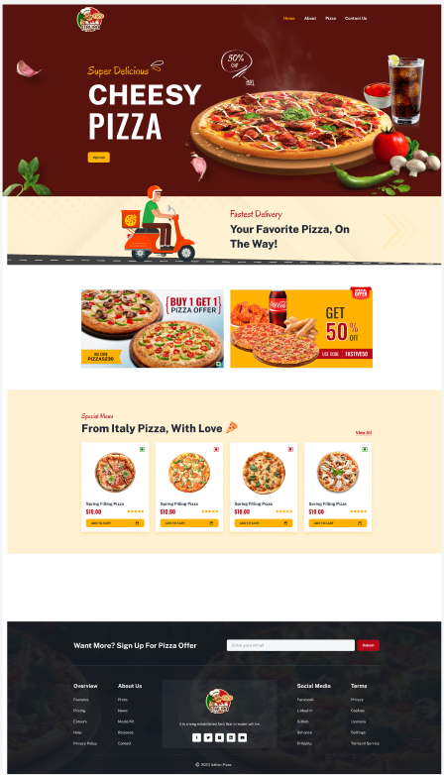
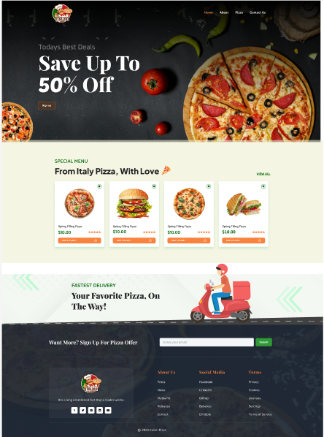
Basic Designs
Design:1
Design:2

Slide 10
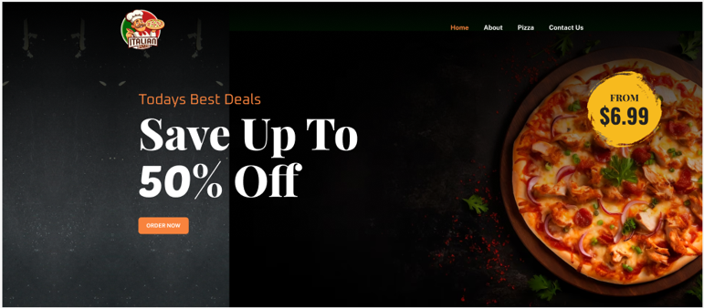
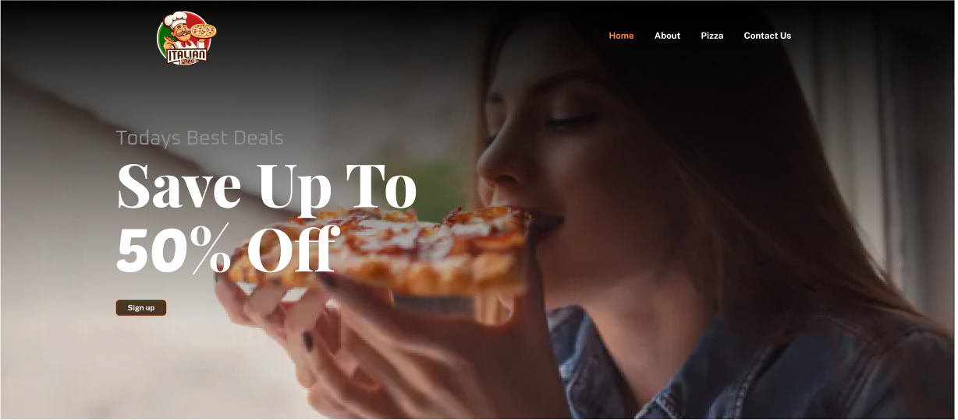
Feedback 1:Hero Section
Before Feedback
After Feedback

Slide 11
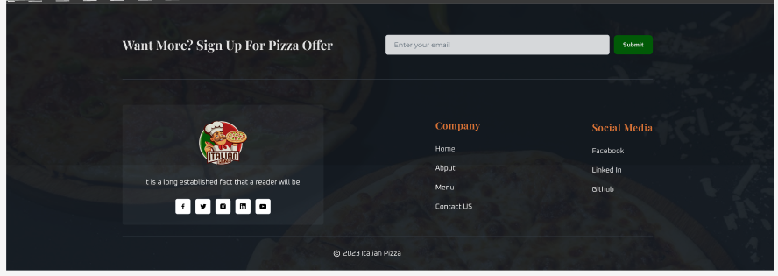
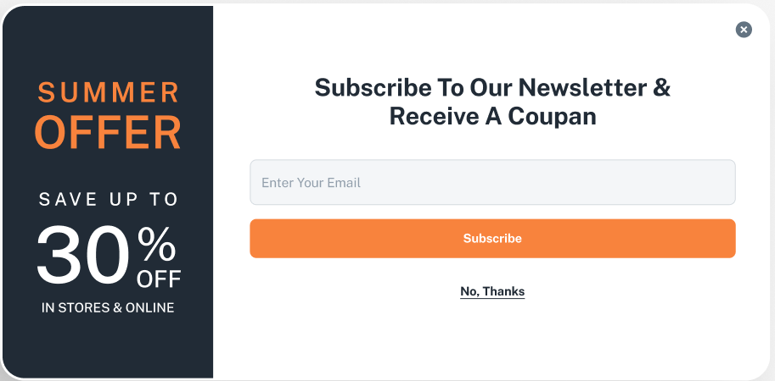
Feedback 2: Mail-Chimp Form
Before Feedback
After Feedback

Slide 12
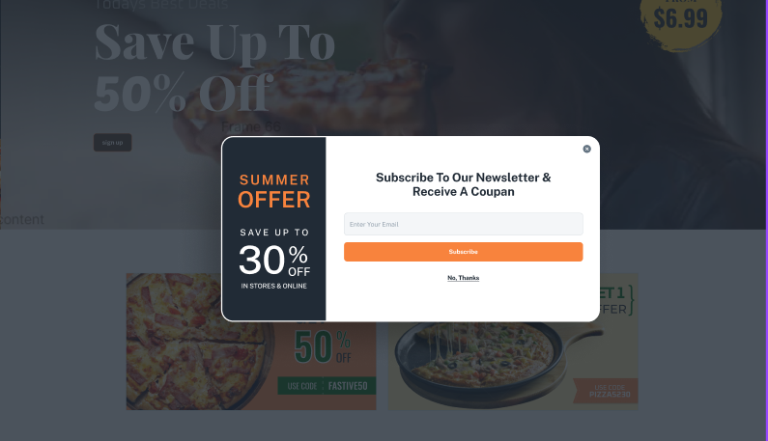
Position of mail chimp form

Slide 13
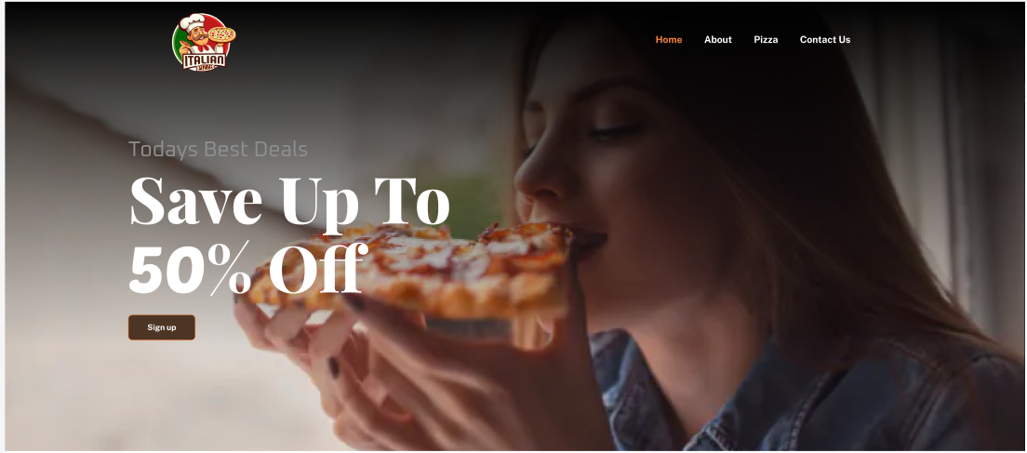
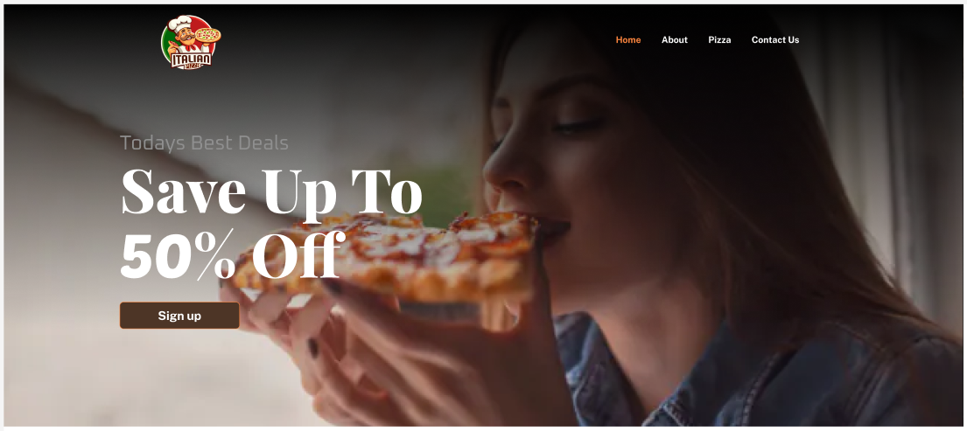
Feedback 3: Sign up button
Before Feedback
After Feedback

Slide 14
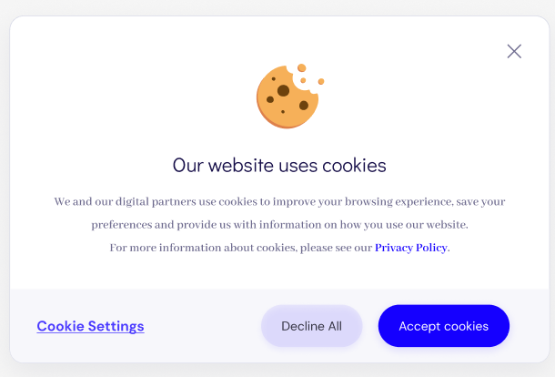
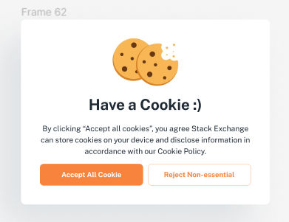
Feedback 4: Cookie pop-up Design
Before Feedback
After Feedback
Final Prototype Figma Link is Here

Slide 15

METHOD OF PERSUASION

Slide 16
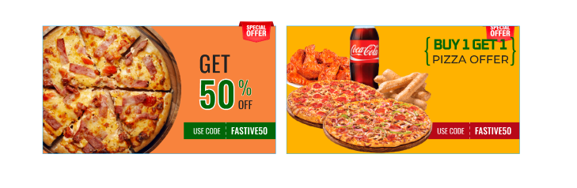
Scarcity
Limited Time Offer:
By stating that the "Buy One Get One Free Pizza" coupon is available for a "limited time only," We create a sense of urgency. Customers are more likely to take action when they believe they might miss out on a great deal.

Slide 17
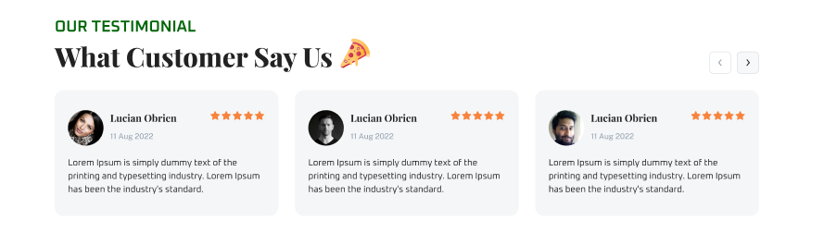
Social Proofs
Social proof is established by showcasing positive feedback and experiences from real customers.

Slide 18
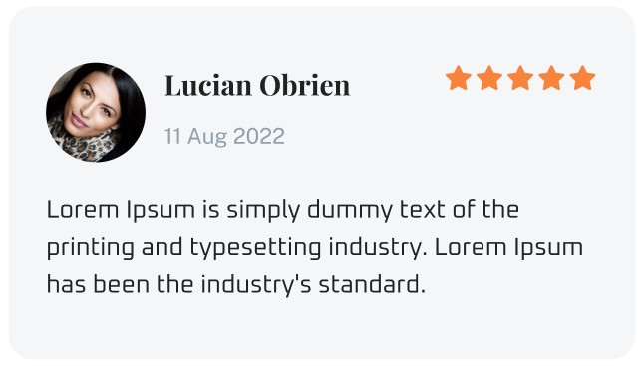
Liking
Ratings:
The ratings are a visual representation of customer satisfaction. Five stars are universally associated with excellence and including them in the testimonials immediately communicates that these customers had an exceptionally positive experience.

Slide 19
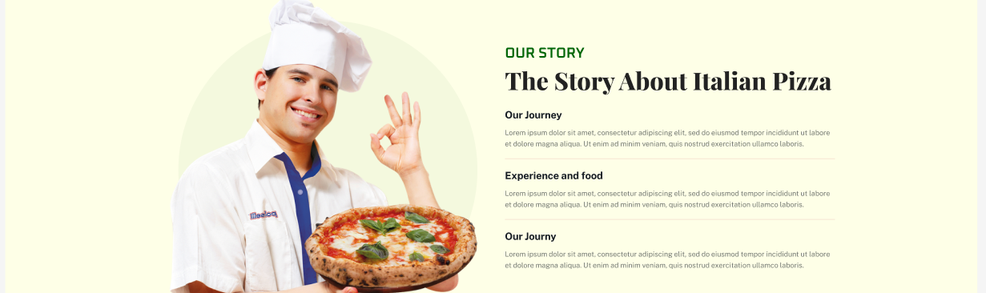
Commitment
Quality Ingredients:
This section emphasizes the commitment to using high-quality, fresh ingredients in every pizza. Quality is a crucial aspect of many food brands, especially in the pizza industry.
Customer Happiness Guarantee:
This section reassures customers that their satisfaction is a priority, and the brand is committed to resolving any issues to ensure a positive experience.

Slide 20
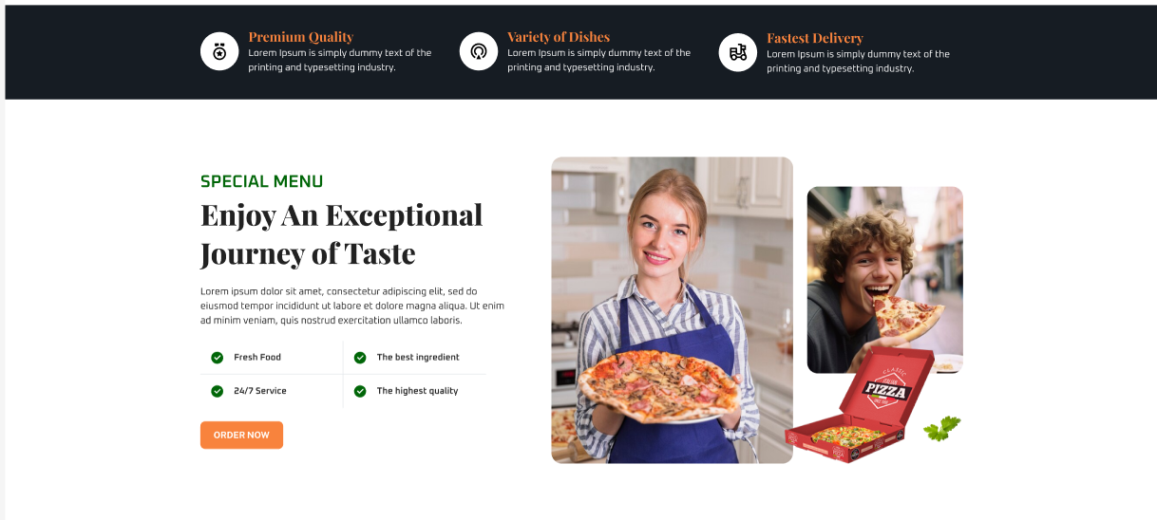
Consistency
Promotional and Content Strategy :
Consistency in promotional messaging and content strategy is emphasized to maintain a unified brand message across different channels.
Incorporation of Customer Service :
Including customer service considerations recognizes the importance of consistent communication and responsiveness for building trust.

Slide 21
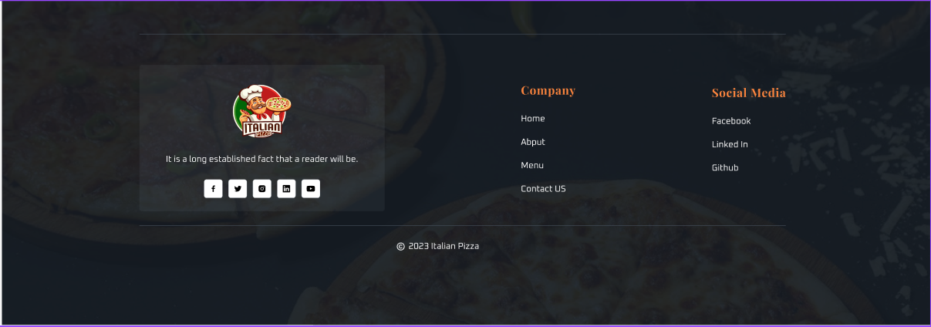
Authority
Brand Authority:
The advice is grounded in the concept of brand authority, which involves showcasing expertise, reliability, and trustworthiness in a specific industry—in this case, the pizza industry.

Slide 22
Development
Crafted a dynamic and responsive pizza restaurant website using React Material UI components within the NextJS framework to deliver an engaging user experience.
Integrated Mailchimp functionality for streamlined newsletter subscriptions.
Implemented Google Analytics to track website performance, user engagement, and visitor behavior, facilitating data-driven decisions for continuous optimization and improvement.
Development link is Here

Slide 23
Conclusion
In creating our Italian pizza restaurant website, we dedicated ourselves to delivering an exceptional online experience. From designing captivating features to implementing 'Add to Cart' and 'Exclusive Discounts,' each step reflected our commitment to quality and user satisfaction. Navigating challenges, learning, and incorporating valuable feedback, we showcased adaptability and problem-solving prowess.

Slide 24
Thank You!

